Slide 1
Gluconeogenesis

Slide 2
Quiz Question #1
What would be the rate of gluconeogenesis be in a type 1 diabetic?
Very high because of a lack of insulin
Very low because of a lack of insulin
Very high because of a lack of insulin responsiveness
Very low because of a lack of insulin responsiveness
Notes:
A

Slide 3
Quiz Question #2
Which enzyme causes anaplerosis?
Pyruvate carboxylase (PC)
Phosphoenolpyruvate Carboxykinase (PEPCK)
Glucose-6-phosphatase (G6Pase)
Fructose-1,6-bisphosphatase (FBPase)
Notes:
A

Slide 4
Quiz Question #3
How does insulin regulate gluconeogenesis via the transcription factor FOXO?
Insulin increases the levels of FOXO causing less gluconeogenesis
Insulin decreases the levels of FOXO causing less gluconeogenesis
Insulin increases the phosphorylation of FOXO causing less gluconeogenesis
Insulin decreases the phosphorylation of FOXO causing less gluconeogenesis
Notes:
C

Slide 5
Learning Objectives
Describe the tissues where gluconeogenesis occurs and the key enzymatic determinants of this specificity.
Explain the major precursors of gluconeogenesis, including where they are derived from and at what step they integrate.
Evaluate how the flow of each these precursors is regulated differently, dependent on where they enter the gluconeogenic pathway.
Analyse the energetic costs of gluconeogenesis, given the precursor substrate.
Describe how chronic activation of gluconeogenesis results in ketone body production from the liver.
Understand the importance of the Cori and Cahill cycles in recycling waste products back to glucose.
Recognize the key steps by which gluconeogenesis is controlled by allosteric control, protein phosphorylation and transcriptional changes, especially in response to insulin, glucagon/adrenaline and Cortisol.
Explain how the cell ensures that gluconeogenesis and glycolysis do not occur simultaneously.

Slide 6
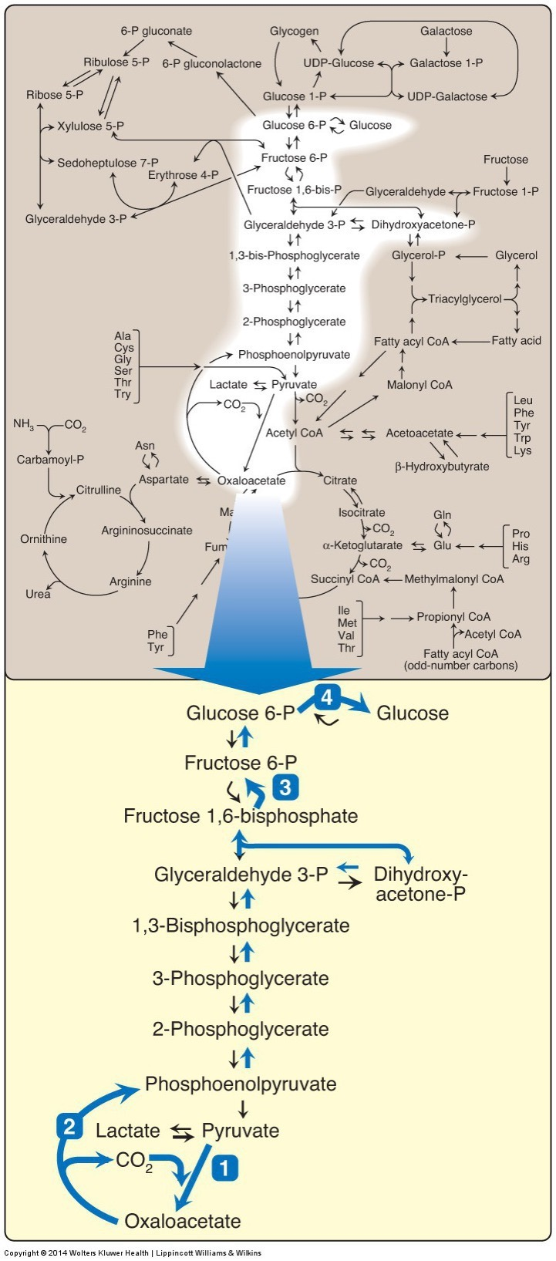
The gluconeogenic pathway
Very similar to glycolysis
Starts with
Lactate, Glycerol and Amino Acids (Alanine)
Three big differences
Glucose-6-Phosphatase instead of reversed Glucokinase
Fructose 1,6 Bisphosphatase instead of reversed PFK1
Pyruvate -> OAA -> PEP (skips pyruvate kinase)
Glycolysis was PEP -> Pyruvate

Slide 7
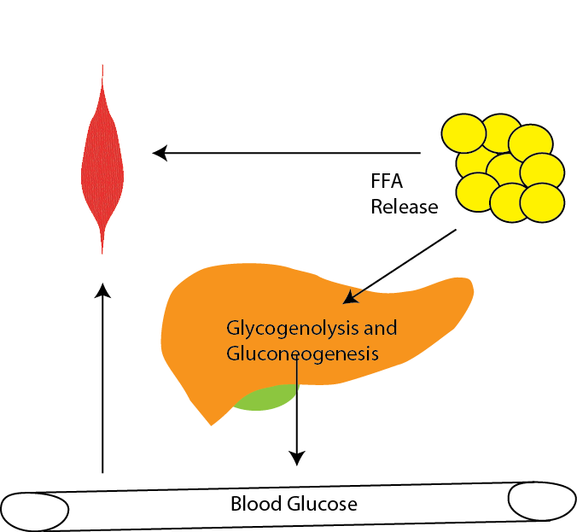
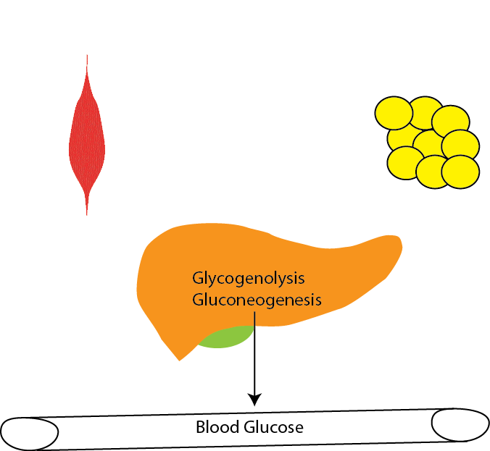
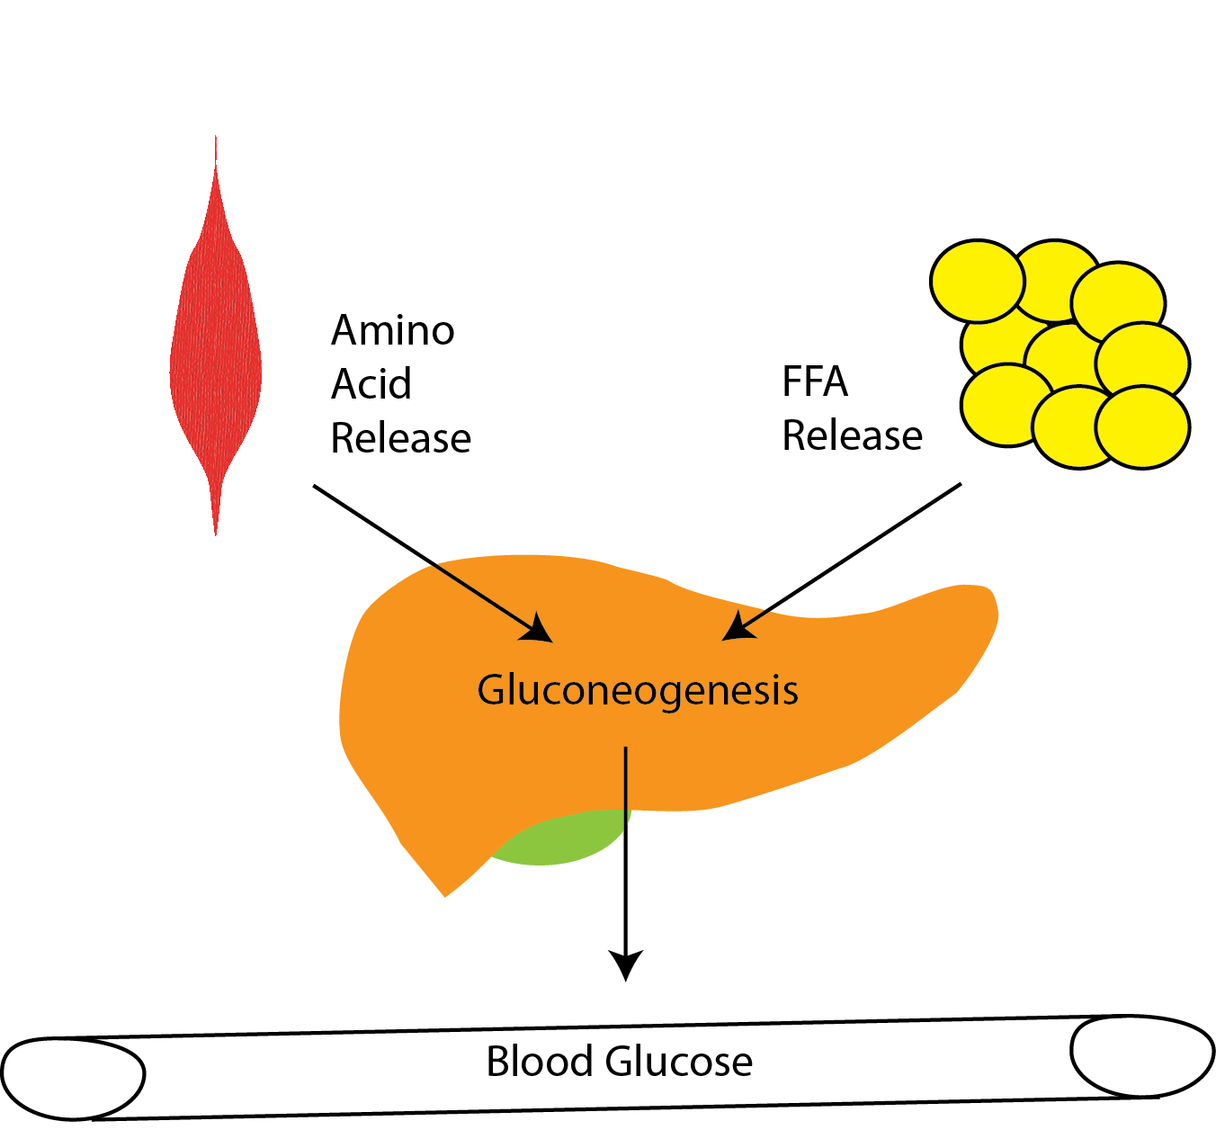
Gluconeogenesis Can Be Activated by Hormones
Adrenaline
Glucagon
Cortisol

Slide 8
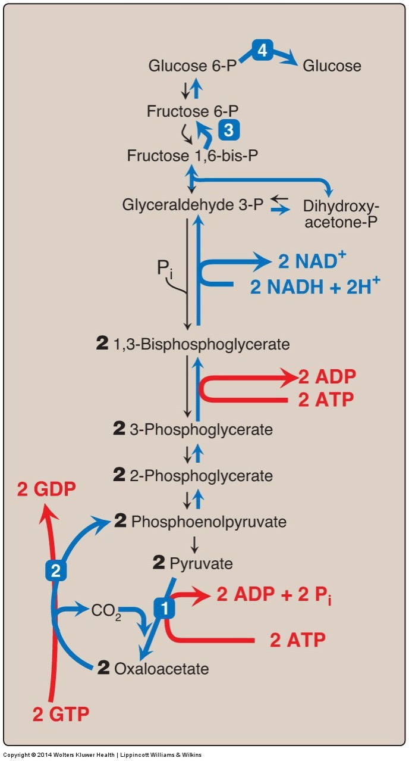
Gluconeogenesis is Expensive
Glycolysis to Lactate +2 ATP
Glycolysis, Pyruvate Oxidation, ETC +32 ATP
Gluconeogenesis
Notes:
Glycolysis followed by gluconeoegenesis is net energy costly, therefore never want both at the same time

Slide 9
Calculate Energy Requirements for GNG
For each substrate (Lactate, Glycerol and Alanine) trace the path to glucose and note the following
When NADH or ATP is used
How many substrates are needed to make one glucose
Which regulatory steps need to be passed for that substrate (PEPCK, PC, FBPase, G6Pase)

Slide 10
Energy Consumption and GNG
How much glucose does an average person make
Why is gluconeogenesis higher in obese type 2 diabetics
Which group is using more energy?
How does this relate to basal metabolic rates?
Magnusson, I., Rothman, D. L., Katz, L. D., Shulman, R. G. & Shulman, G. I. Increased rate of gluconeogenesis in type II diabetes mellitus. A 13C nuclear magnetic resonance study. J. Clin. Invest. 90, 1323–1327 (1992).
Notes:
Glucose Produced
Control – 6.1 x 75 x 24 x 60 = 588,528 umoles or 589 mmoles or 0.59 moles
DM – 9.8 * 70 * 24 * 60 = 1.06 moles
ATP Needed
0.59*6 = 3.5 moles of ATP
1.06*6 = 6.4 moles of ATP
3.5 * 12 = 42 Cal
6.4 * 12 = 77 Cal

Slide 11
The ketogenic diet
Afaaf Nassif

Slide 12
What is the ketogenic diet?
Has been used since the 1920’s for epilepsy
Was modified in the 1970’s to the ‘Atkins Diet’
Now
5% or less of CHO
15-20% PRO
75-80% fat
Notes:
the classical ketogenic diet which has been used since the 1920s and is based on a ratio of fat: carbohydrate and protein of 3:1 or 4:1
A modification to this diet that used medium-chain triglycerides (MCT) as an alternative fat source was introduced in the 1970s and became popular for weight loss – it was also known as ‘Atkins Diet’
MCT yield more ketones per kilocalorie of energy provided than long-chain triglycerides (LCT) do, they are absorbed more efficiently, and are carried directly from the digestive system to the liver by the portal vein.
Typical ketogenic diet followed today has less than 50g of CHO which should result in less than 5% of energy intake with 15-20% PRO intake and 75-80% fat intake

Slide 13
Current use for ketogenic diet
Weight loss
Some glycogen storage diseases (GSD)
Neurodegenerative disorders
Traumatic brain injury and stroke
Mood disorders
Diabetes

Slide 14
Mechanisms used during ketogenic diets
The high fat and restricted carbohydrate content of the diet is thought to mimic the biochemical response to starvation, when ketone bodies become the main fuel for the brain's energy demands
Notes:
The production of ketone bodies is called ketogenesis and which occurs principally in the mitochondrial matrix in the liver.

Slide 15
Cataplerotic effects
Reoccurring OAA being pulled out of TCA to produce ketone bodies

Slide 16
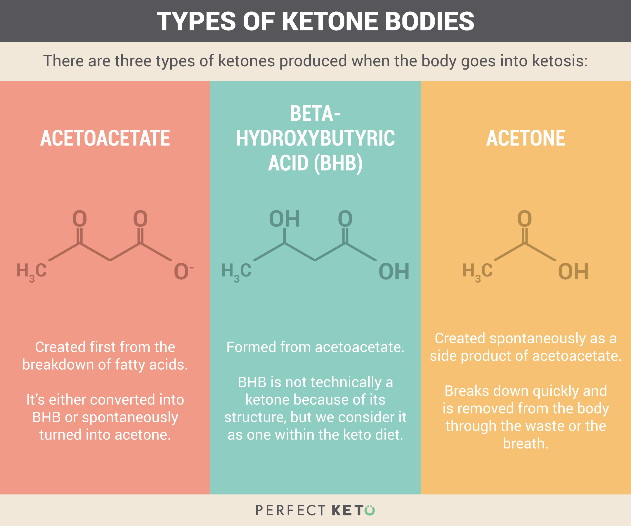
Notes:
There are three types of ketone bodies that are produced at higher than normal levels when the body is in starvation

Slide 17
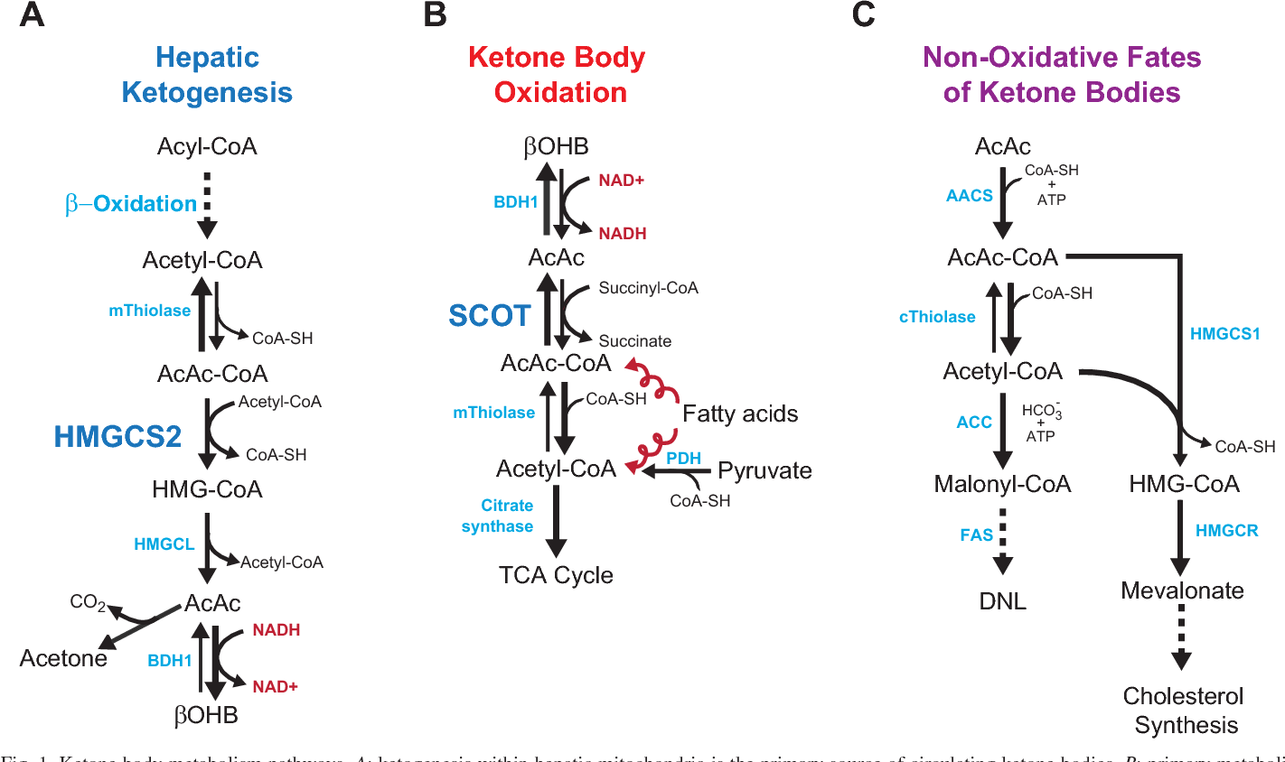
Notes:
The main KB produced in the liver is acetoacetate, but the primary circulating ketone is b-hydroxybutyrate which is reduced to a hydroxyl group.
Under normal conditions of adequate dietary carbohydrate, the production of free acetoacetic acid is negligible, and it is rapidly metabolized by various tissues, especially the skeletal and heart muscles.
In conditions of overproduction of acetoacetic acid, it accumulates above normal levels and part of it is converted to the other two KBs leading to ketonemia and ketonuria (presence of KBs in the blood and urine).
The characteristic ‘sweet’ breath odor of ketosis is caused by acetone, which, being a very volatile compound, is eliminated mainly via respiration in the lungs.

Slide 18
Notes:
KBs are then used by tissues as a source of energy through a pathway that leads to formation from b-hydroxybutyrate of two molecules of acetyl CoA, which are used ﬁnally in the Krebs cycle which will then be used as energy throughout the body

Slide 19
Deficiencies and risk factors
Dietary fiber deficiency
Vitamin and mineral deficiencies
Selenium
Unfavorable changes in LDL-C levels
Kidney stone formations
Uric acid stones
Dyslipidemia and high number of hypoglycemic episodes
Notes:
Dietary fiber
Increased nutrient absorption rate → goes through GI faster resulting in decreased absorption of nutrients.
Hunger → because limited fiber the chyme is not viscous which means that it will go from stomach to small intestine faster which leave less time for satiety
Can cause diarrhea because no aid in bulking of fecal matter
Vitamins
The keto diet is known to be deficient in most vitamins and minerals and may be deficient in trace minerals → specific study done on selenium deficiency for patients following a keto diet for epilepsy
This was measured with whole‐blood or serum selenium as part of routine laboratory evaluation every 3 months
Eight of the nine had selenium levels below the normal range (six initially, and two developed low selenium levels on serial testing)
Risk factors
potential unfavorable changes in low-density lipoprotein cholesterol values
There have been many reports of kidney stones while on the ketogenic diet → most are uric acid stones
KD results in low urinary pH, which facilitates the formation of uric acid crystals because the solubility of uric acid decreases greatly as pH falls.
But may also be associated with dyslipidemia and a high number of hypoglycemic episodes for adults with Type I diabetes

Slide 20
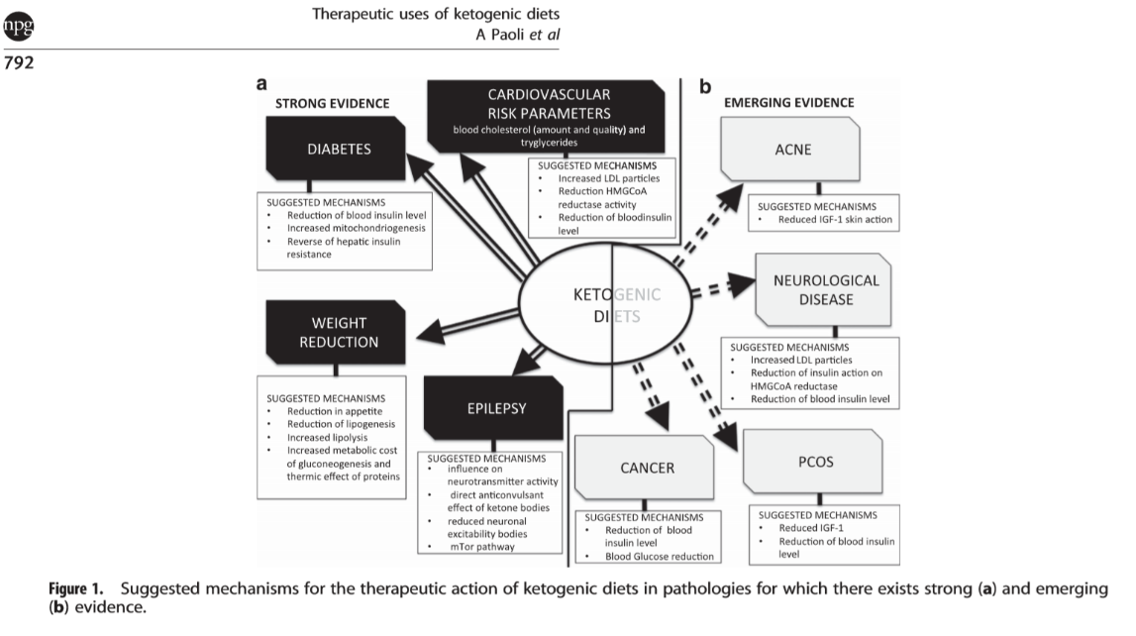
Using the ketogenic diet as treatment methods
Notes:
Introduce that it is often used as a method of treatment
Epilepsy – idiopathic mechanism

Slide 21
Using the ketogenic diet as treatment methods
Cardiovascular disease
Tarui’s disease
No clear benefit of ketogenic diet on cardiovascular risk factors
No change in blood pressure
Low-fat diet → total cholesterol and LDL-C levels decreased
Low-CHO diet → HDL-C and triglyceride had favorable changes
Loss of PFK1 isoform in muscle therefore cannot break down glucose through glycolysis
Build up of glycogen in muscle which causes myopathy
Avoid PFK1 pathway on ketogenic diet because little to no glucose intake
Notes:
By implementing ketogenic diet, no need to use PFK1 therefore makes energy other means without glycogen build up

Slide 22
Using the ketogenic diet as treatment methods
Diabetes (type 1 &2)
Two defined diets
Atkins: low CHO/PRO and high fat
Ketogenic: low CHO and high PRO/fat
Trail one: type 1 diabetes (untreated with insulin)
From 500mg/dL to 100mg/dL within a few days
Trail two: reversing diabetic complications in type 1
Monitored urinary albumin/creatinine ratios
On ketogenic diet → blood glucose was normalized within one week
Most cases diabetic nephropathy was completely reversed
Trail three: type 2 diabetes
Monitored urinary albumin/creatinine ratios
Showed similar results as previous trial
Notes:
There was a study done 2013 to see the results of using the ketogenic diet as a treatment method for diabetes
They defined the ketogenic diet as a low- carb, high- protein diet and the Atkins diet as a low-carb, low-protein and high-fat diet
They initially assessed if mice with type 1 diabetes, untreated with insulin
the next day their blood glucose levels had fallen from about 500 to about 400 mg/dL, and every day their blood glucose continued to fall by about 100 mg/dL, until the levels were approximately normal (100 mg/dL)
Next assessed if the ketogenic diet would be effective in reversing diabetic complications, which are not reversed even by normalization of blood glucose.
by monitored urinary albumin/creatinine ratios until they clearly indicated nephropathy.
10-fold increase in albumin/creatinine ratios in the type 1 diabetic mice, half the mice were placed on the ketogenic diet.
As before, blood glucose in type 1 diabetic mice was normalized within 1 week of placing the mice on the ketogenic diet; blood glucose was slightly but significantly reduced in wild-type controls.
Within 2 weeks of the switch, 4 of 12 diabetic mice had died, whereas none of the mice on the ketogenic diet had died.
The mice were then sacrificed, and kidney gene expression was assessed. they were all at least partially reversed (in most cases completely reversed) by the ketogenic diet.
We carried out a similar study in type 2 (db/db) diabetic mice with the same result
These data suggest that a plausible treatment for diabetic complications would be for patients to be placed on a low-carbohydrate, high-protein diet Atkins-type diet which entails relatively high compliance compared to the classic ketogenic diet. After 6 months, patients would then be placed on a classic ketogenic diet, monitoring relevant complications
Important to remember that ketogenic and Atkins diets have shown different results in animals’ vs human testing

Slide 23
Summary of ketogenic diet
The good
Some lose weight
Many studies showing possible aid and prevention
Neurodegenerative diseases
Mood disorders
Glycogen storage diseases (GSD)
Diabetes
Notes:
Net expense of gluconeogenesis is -12 ATP along with expenditure of ketone body production will likely have negative energy balance

Slide 24
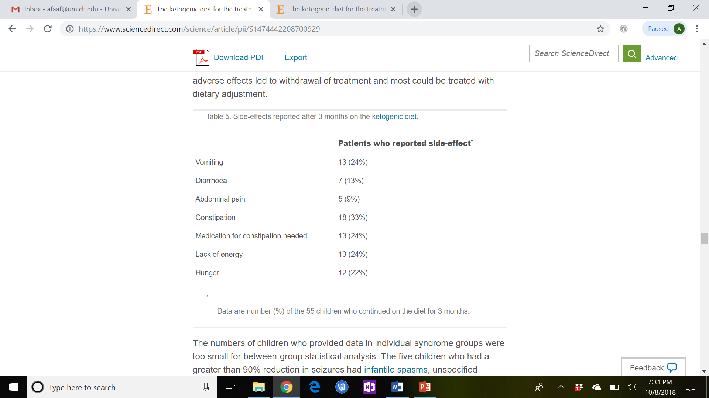
Summary of ketogenic diet
The bad
Not realistic for dietary lifestyle
Weight cycling
Does not teach good eating habits
Does not guarantee weight loss
Brain prefers glucose as source of energy
Association with dyslipidemia and a frequent hypoglycemic episodes for adults with type 1 diabetes
Risk of kidney stones
Reported side effects → overall not enjoyable
Notes:
Does not teach realistic diet lifestyle → good eating habits
Eats lots of high fat food, animal protein
Tends to eat too much animal products and not enough vegetables resulting in vitamin deficiencies, high intake of cholesterol,
Realistically, this is diet is hard to sustain over a long period of time therefore effects (weight loss) will likely to be temporary
Not a guaranteed way to lose weight
the initial rapid weight loss is mostly from glycogen depletion (which carries a lot of water with it), not actual fat mass loss, though that may happen later

Slide 25
Regulation of Gluconeogensis
Key enzymes
PEPCK, PC, FBPase, G6Pase
Several layers of regulation
Metabolite regulation of enzymes
PC by Acetyl-coA
FBPase by ATP, lowered AMP/F26bP/citrate
Hormones
Glucagon/Adrenaline -> PKA protein phosphorylation of FPBase2/PFK2 and Pyruvate Kinase
Via CREB -> Increased levels of PEPCK, G6Pase
Insulin -> Akt dependent dephosphorylation of FPBase2/PFK2 and Pyruvate Kinase
Via FOXO inhibition -> decreased levels of PEPCK, G6Pase
Cortisol -> via glucocorticoid receptor -> increase levels of PEPCK, PDK4, G6Pase, FBPase
Indirect by regulating flow of substrates

Slide 26
Clicker Question
Can fatty acids be converted into glucose?
Yes
No
Sometimes

Slide 27
Phosphoenolpyruvate Carboxykinase (PEPCK)
First committed and rate limiting step
PEPCK not regulated allosterically
Insulin negatively regulates this transcriptionally (inactivation of FOXO)
Cortisol positively regulates this transcriptionally
Cataplerotic, reduces OAA levels

Slide 28
Pyruvate Carboxylase
Can replenish oxaloacetate, bypassing TCA cycle (anaplerotic)
Activated by acetyl-CoA
Important for conversion of both Alanine and Lactate back into glucose
Anaplerotic, increases OAA levels

Slide 29
Case Study: Pyruvate Carboxylase Deficiency
Autosomal recessive, broadly 1:250,000 but up to 1:100 in some Algonquin/Cree Native Canadians
Explain why these phenotypes may exist
Hyperglycemia
Lactic acid buildup
Muscle weakness
Hyperketonemia
Hyperammonia
What diets should be taken or avoided?
Notes:
Provide a high-carbohydrate and high-protein diet with frequent feedings to help prevent dependence on gluconeogenesis.
ketogenic diet is an absolute contraindication, shown to worsen the acidosis into a life-threatening range.

Slide 30
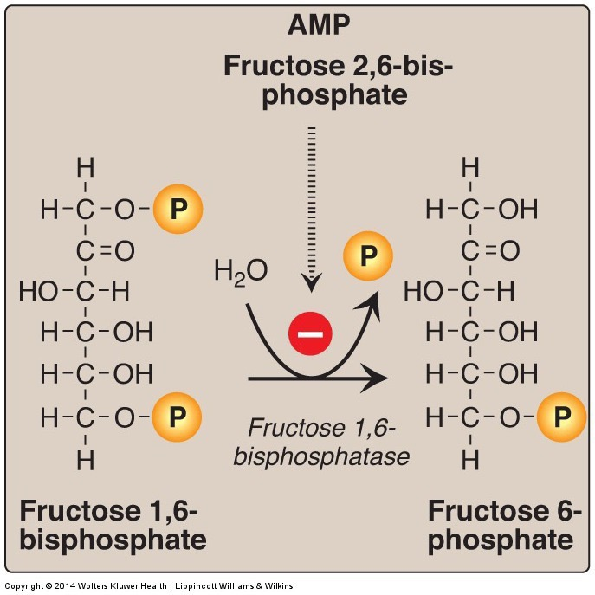
Fructose bisphosphatase 1 reverses PFK1
Inhibited by
F26BP
AMP

Slide 31
PFK2 and FBPase2 are the same Enzyme

Slide 32
Effects of Fructose 2,6 bisphosphate on PFK1/FBPase
PFK1 Activity
FBPase Activity

Slide 33
How would glucagon and adrenaline affect gluconeogenesis in the liver at this step?
Would inhibit it by inhibiting PFK2, activating FBPase2
Would inhibit it by activating PFK2, inhibiting FBPase2
Would activate it by inhibiting PFK2, activating FBPase2
Would activate it by activating PFK2, inhibiting FBPase2
Notes:
B
Would this be true of muscle as well

Slide 34
Co-ordinate control of gluconeogenesis and glycolysis
 | Glycolysis | Gluconeogenesis
Activity of Glucokinase | High (Glucose High) | Low (Glucose Low)
Activity of Glucose-6-Phosphatase | Low (Transcriptional) | High (Transcriptional)
Activity of Phosphofructokinase | High (via F26BP high/AMP) | Low (via F26BP low/ATP/Citrate)
Phosphorylation of PFK2 | Dephosphorylated (Active) | Phosphorylated (Inactive)
Activity of FBPase | Low (via high F26BP/AMP and low Citrate) | High (via low F26BP/AMP and high Citrate)
Phosphorylation of Pyruvate Kinase | Dephosphorylated (Active) | Phosphorylated (Inactive)
Activity of Pyruvate Kinase | High (AMP/F16BP) | Low (Alanine)
Activity of Pyruvate Carboxylase | Low | High (Acetyl-CoA)
Activity of PEPCK | Low (Transcriptional) | High (Transcriptional)

Slide 35
Insulin Effects on Gluconeogenesis (Direct)
Thought to be mainly transcriptional (via a transcription factor FOXO)
Insulin Represses
Glucose-6-Phosphatase
PEPCK
Promotes the dephosphorylation of PFK2 and Pyruvate Kinase
What would that do to glycolysis and gluconeogenesis

Slide 36
Insulin Resistance and Diabetes
Glucose Production
These graphs are fasting glucose vs the indicated
Solid dots (on the right) are diabetics
Open dots are non-diabetics
Glucose Oxidation
Bogardus C, Lillioja S, Howard B V, Reaven G, Mott D. Relationships between insulin secretion, insulin action, and fasting plasma glucose concentration in nondiabetic and noninsulin-dependent diabetic subjects. J. Clin. Invest. 1984;74(4):1238–1246.
Lipid Oxidation

Slide 37
Obesity is associated with hyperinsulinemia
Nutritional overload (obesity)
Protective insulin resistance
Tissues respond worse to insulin
More insulin is secreted
Tissues more desensitized
More insulin is secreted
Eventually beta cells cannot compensate

Slide 38
Obesity Related Progression of Diabetes
Individuals vary in how this progresses.
At your table
List some reasons why someone may progress from weight gain to type 2 diabetes

Slide 39
Cortisol Effects on Gluconeogenesis
Via activation of FOXO (increases protein levels)
G6Pase
PEPCK
Notes:
This is unsatisfyingly compelling

Slide 40
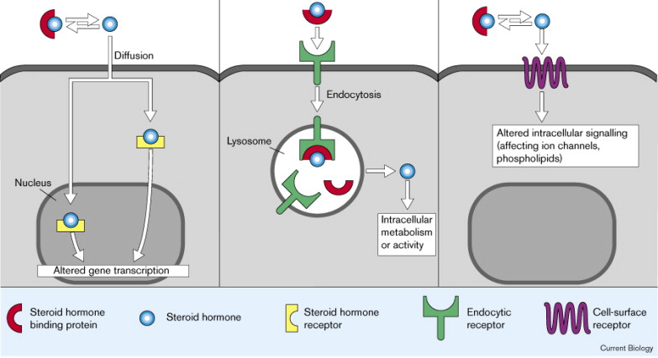
Nuclear Hormone Receptors
Insulin
Glucagon
Epinephrine
Cortisol

Slide 41
Why would transcriptional alterations be preferable?
Faster
More permanent
More easily reversible
Energetically efficient

Slide 42
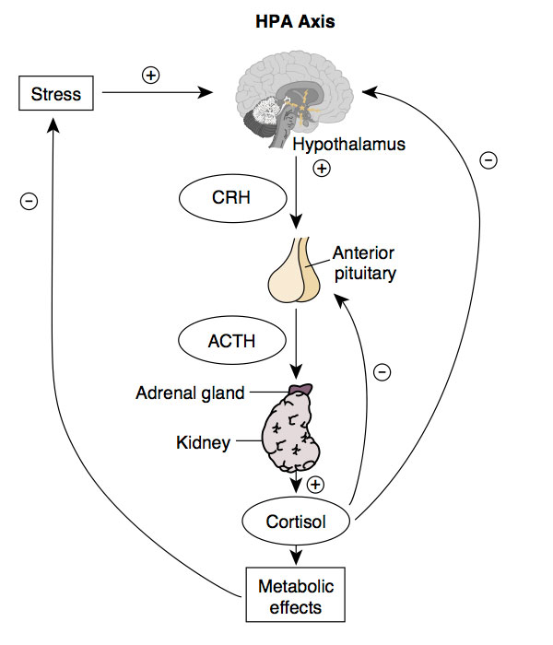
Stress and Diabetes Risk
Risk of developing Type 2 diabetes based on general distress
Mommersteeg, P. M. C., Herr, R., Zijlstra, W. P., Schneider, S. & Pouwer, F. Higher levels of psychological distress are associated with a higher risk of incident diabetes during 18 year follow-up: Results from the British household panel survey. BMC Public Health 12, (2012).
Notes:
Increased relative risk by 33% but attenuated when controlling for SES

Slide 43
Gluconeogenesis is also regulated indirectly

Slide 44
Cori and Cahill Cycles Provide Substrates
Cahill Cycle
Cori Cycle
During exercise
Net cost -4 ATP
During Amino Acid Breakdown
Net cost -13ATP
Notes:
Why alanine

Slide 45
Gluconeogenesis is dependent on substrates
Lactate
Amino Acids (like Alanine)
Glycerol
Lipolysis plays a special role
Fatty Acids -> Acetyl-CoA
Acetyl-coA activates pyruvate carboxylase
Fatty acid oxidation provides energy
Provides glycerol substrate

Slide 46
How does insulin co-ordinately regulate gluconeogenesis
Protein breakdown and and amino acid release
Suppressed by insulin, activated by cortisol via FOXO inactivation (atrogenes)
Lipolysis and fatty acid release
Suppressed by insulin, promoted by adrenaline and cortisol
Direct effects on liver

Slide 47
Learning Objectives
Understand the function of the pentose phosphate shunt and why NADPH generation is important.
Describe the key steps by which gluconeogenesis is controlled by protein phosphorylation and by allosteric control.
Explain how transcriptional changes can alter gluconeogenesis in response to insulin and cortisol.
Explain how the cell ensures that gluconeogenesis and glycolysis do not occur simultaneously.
Understand how, in chronic fasting other tissues provide substrates for gluconeogenesis to the liver.

